Slide 1
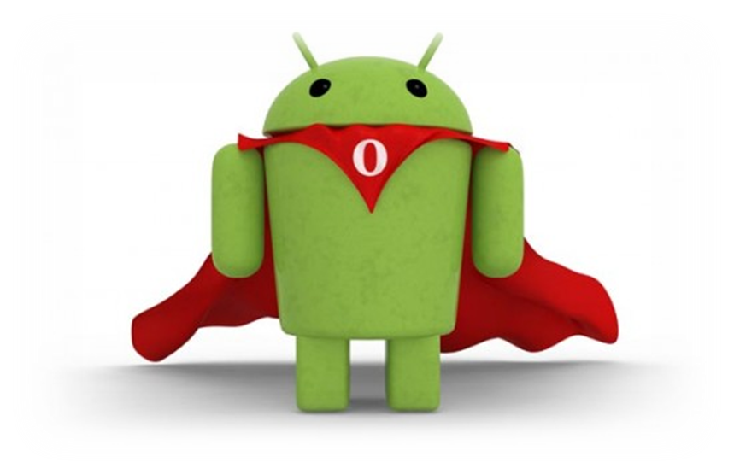
Application Framework
Part 1 : Application Components
Notes:
Android applications are written in the Java programming language. The compiled Java code — along with any data and resource files required by the application — is bundled by the aapt tool into an Android package, an archive file marked by an .apk suffix. This file is the vehicle for distributing the application and installing it on mobile devices; it's the file users download to their devices. All the code in a single .apk file is considered to be one application.
In many ways, each Android application lives in its own world:
By default, every application runs in its own Linux process. Android starts the process when any of the application's code needs to be executed, and shuts down the process when it's no longer needed and system resources are required by other applications.
Each process has its own Java virtual machine (VM), so application code runs in isolation from the code of all other applications.
By default, each application is assigned a unique Linux user ID. Permissions are set so that the application's files are visible only that user, only to the application itself — although there are ways to export them to other applications as well.
It's possible to arrange for two applications to share the same user ID, in which case they will be able to see each other's files. To conserve system resources, applications with the same ID can also arrange to run in the same Linux process, sharing the same VM.

Slide 2
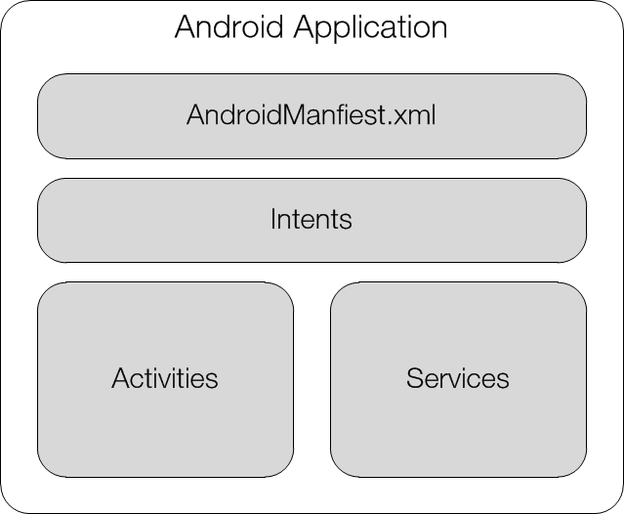
Application Components
Activities
Services
Broadcast receivers
Content providers

Slide 3
Activities
An activity presents a visual user interface for one focused task. Usually each screen has a single activity.
  e.g. an activity might present a list of menu items users can choose from or it might display photographs along with their captions
Notes:
A text messaging application might have one activity that shows a list of contacts to send messages to, a second activity to write the message to the chosen contact, and other activities to review old messages or change settings. Though they work together to form a cohesive user interface, each activity is independent of the others. Each one is implemented as a subclass of the Activity base class.
An application might consist of just one activity or, like the text messaging application just mentioned, it may contain several. What the activities are, and how many there are depends, of course, on the application and its design. Typically, one of the activities is marked as the first one that should be presented to the user when the application is launched. Moving from one activity to another is accomplished by having the current activity start the next one.
Each activity is given a default window to draw in. Typically, the window fills the screen, but it might be smaller than the screen and float on top of other windows. An activity can also make use of additional windows — for example, a pop-up dialog that calls for a user response in the midst of the activity, or a window that presents users with vital information when they select a particular item on-screen.
The visual content of the window is provided by a hierarchy of views — objects derived from the base View class. Each view controls a particular rectangular space within the window. Parent views contain and organize the layout of their children. Leaf views (those at the bottom of the hierarchy) draw in the rectangles they control and respond to user actions directed at that space. Thus, views are where the activity's interaction with the user takes place. For example, a view might display a small image and initiate an action when the user taps that image. Android has a number of ready-made views that you can use — including buttons, text fields, scroll bars, menu items, check boxes, and more.
A view hierarchy is placed within an activity's window by the Activity.setContentView() method. The content view is the View object at the root of the hierarchy. (See the separate User Interface document for more information on views and the hierarchy.)

Slide 4
Services
A service doesn't have a visual user interface, but rather runs in the background for an indefinite period of time. Services are usually started when the phone powers up and runs for the time the phone is turned on.
  E.g. a service might play background music as the user attends to other matters, or it might fetch data over the network or calculate something and provide the result to activities that need it. Each service extends the Service base class.
Notes:
A prime example is a media player playing songs from a play list. The player application would probably have one or more activities that allow the user to choose songs and start playing them. However, the music playback itself would not be handled by an activity because users will expect the music to keep playing even after they leave the player and begin something different. To keep the music going, the media player activity could start a service to run in the background. The system would then keep the music playback service running even after the activity that started it leaves the screen.
It's possible to connect to (bind to) an ongoing service (and start the service if it's not already running). While connected, you can communicate with the service through an interface that the service exposes. For the music service, this interface might allow users to pause, rewind, stop, and restart the playback.
Like activities and the other components, services run in the main thread of the application process. So that they won't block other components or the user interface, they often spawn another thread for time-consuming tasks (like music playback). See Processes and Threads, later.

Slide 5

Broadcast receivers
A broadcast receiver is a component that does nothing but receives and react to broadcast notifications. Many broadcasts originate in system code.
  E.g. announcements that the time zone has changed or a text message has arrived
  that the battery is low
  that a picture has been taken
Notes:
Applications can also initiate broadcasts — for example, to let other applications know that some data has been downloaded to the device and is available for them to use.
An application can have any number of broadcast receivers to respond to any announcements it considers important. All receivers extend the BroadcastReceiver base class.
Broadcast receivers do not display a user interface. However, they may start an activity in response to the information they receive, or they may use the NotificationManager to alert the user. Notifications can get the user's attention in various ways — flashing the backlight, vibrating the device, playing a sound, and so on. They typically place a persistent icon in the status bar, which users can open to get the message.

Slide 6
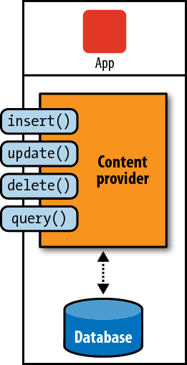
Content providers
A content provider makes a specific set of the application's data available to other applications. The data can be stored in the file system, in an SQLite database, or in any other manner that makes sense
Notes:
The content provider extends the ContentProvider base class to implement a standard set of methods that enable other applications to retrieve and store data of the type it controls. However, applications do not call these methods directly. Rather they use a ContentResolver object and call its methods instead. A ContentResolver can talk to any content provider; it cooperates with the provider to manage any interprocess communication that's involved.
See the separate Content Providers document for more information on using content providers.
Whenever there's a request that should be handled by a particular component, Android makes sure that the application process of the component is running, starting it if necessary, and that an appropriate instance of the component is available, creating the instance if necessary.

